Slide 1



Dialysis of Patients

Slide 2

EXCEL ANALYSIS

Slide 3
KPI - 1 Number of Patients across various summaries

Slide 4
KPI - 2 Profit Vs Non-Profit Stats
Row Labels | Count of Profit or Non-Profit | Count of Profit or Non-Profit2
Non-Profit | 869 | 11.25%
Profit | 6854 | 88.75%
Grand Total | 7723 | 100.00%

Slide 5
KPI - 3 Top 3 Chain Organizations in terms of number of dialysis stations

Slide 6
KPI - 4 Dialysis Stations Stats

Slide 7
KPI - 5 # of Category Text - As Expected

Slide 8
KPI - 6 # of Score Applied – Improvement

Slide 9
KPI - 7 Top 3 Facilities in terms of Total Performance Score
Facility Name | Sum of Total Performance Score
TOTAL RENAL CARE, INC. | 1916
TOTAL RENAL CARE INC | 1122
ISD RENAL INC | 882
Grand Total | 3920

Slide 10
KPI - 8 Average Payment Reduction Rate for 2020

Slide 11

SQL ANALYSIS

Slide 12
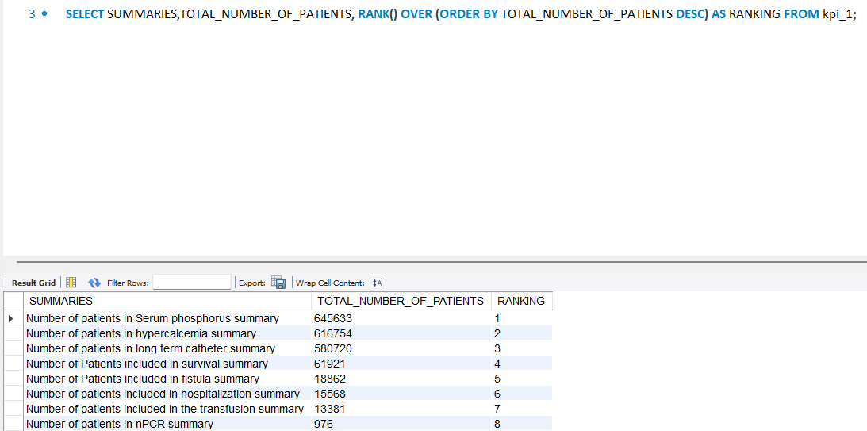
KPI - 1 Number of Patients across various summaries

Slide 13
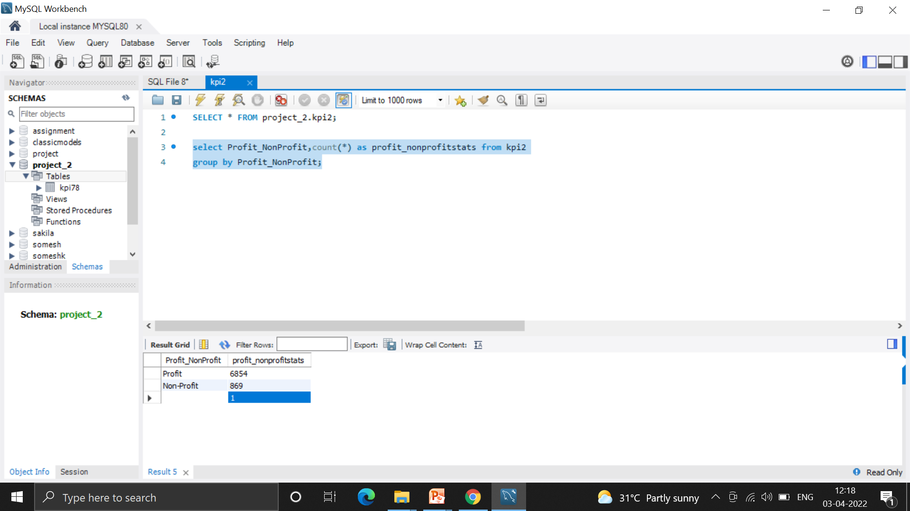
KPI - 2 Profit Vs Non-Profit Stats

Slide 14
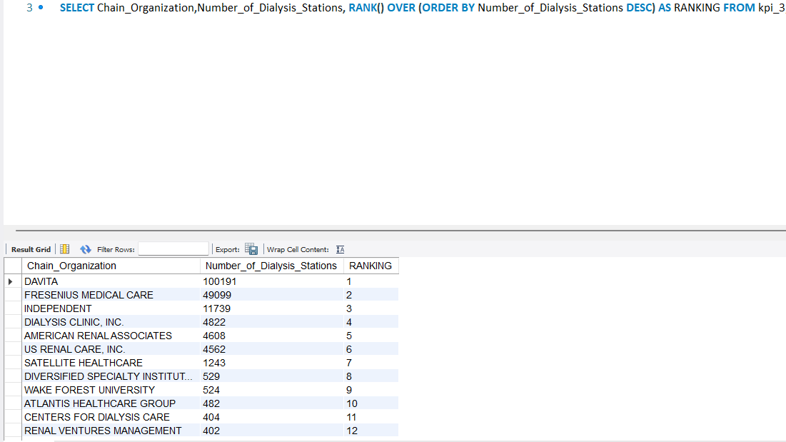
KPI - 3 Top 3 Chain Organizations in terms of number of dialysis stations

Slide 15
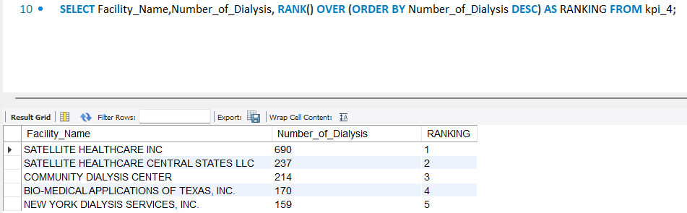
KPI - 4 Dialysis Stations Stats

Slide 16
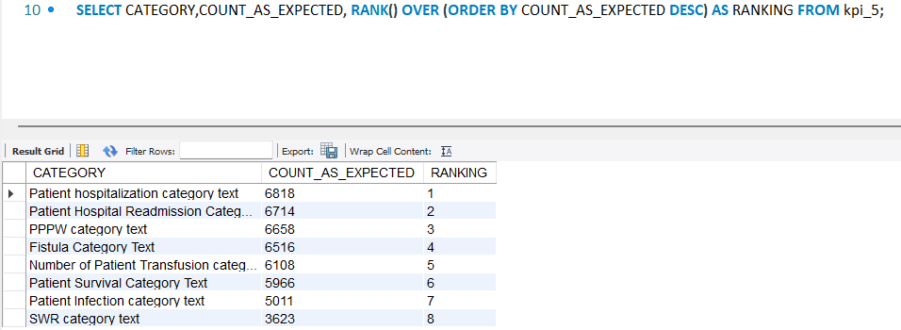
KPI - 5 # of Category Text - As Expected

Slide 17
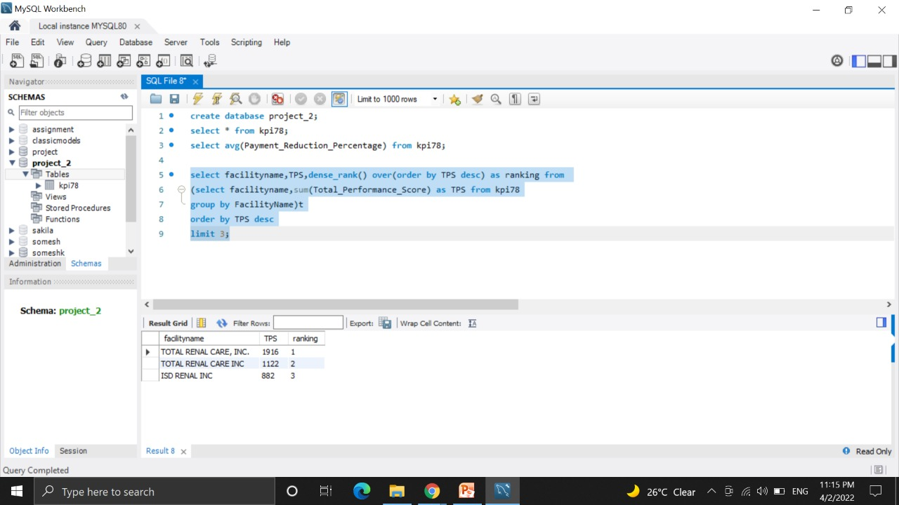
KPI - 7 Top 3 Facilities in terms of Total Performance Score

Slide 18
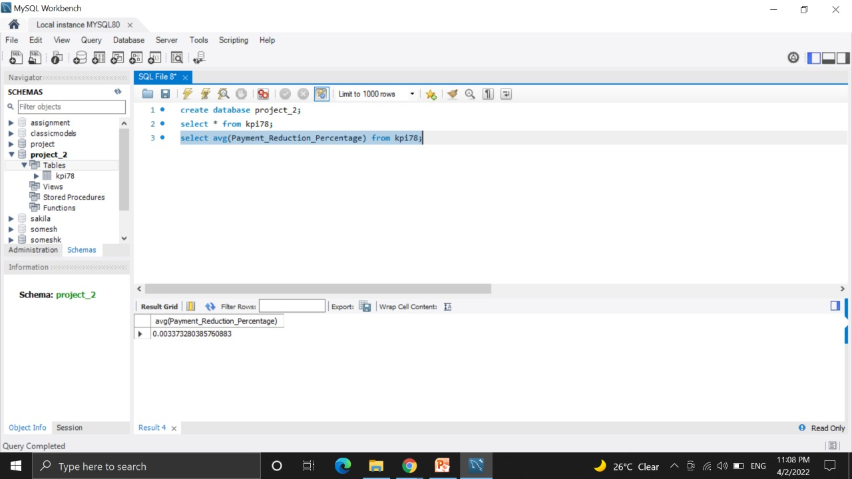
KPI - 8 Average Payment Reduction Rate for 2020

Slide 19

Kpi’s In Tableau-I

Slide 20
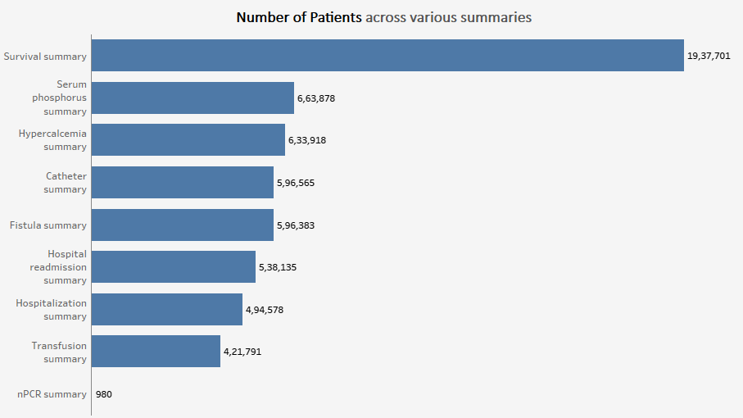
KPI - 1 Number of Patients across various summaries

Slide 21
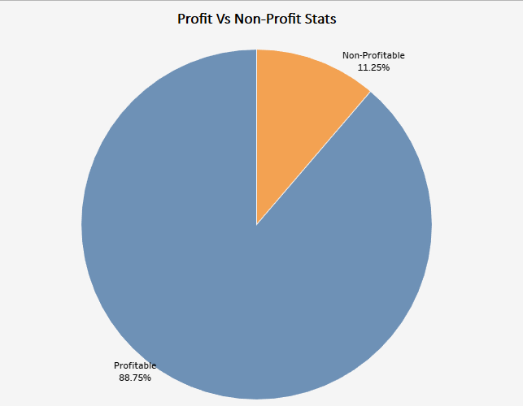
KPI - 2 Profit
Vs
Non-Profit Stats

Slide 22
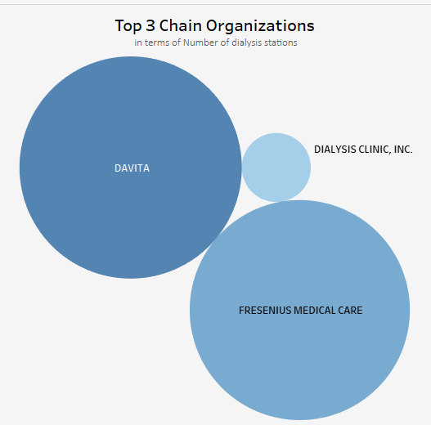
KPI - 3 Top 3 Chain Organizations in terms of number of dialysis stations

Slide 23
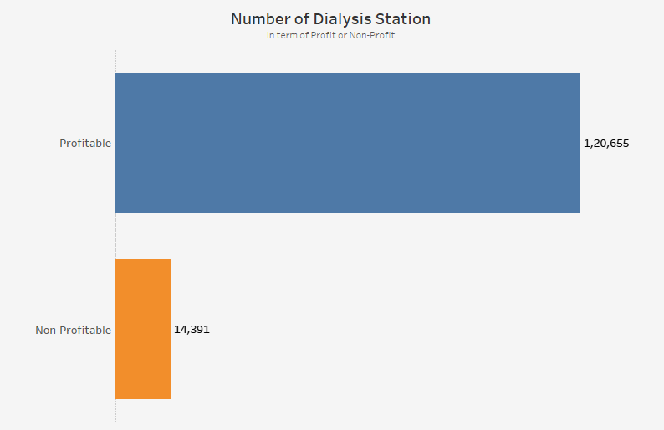
KPI - 4 Dialysis Stations Stats

Slide 24
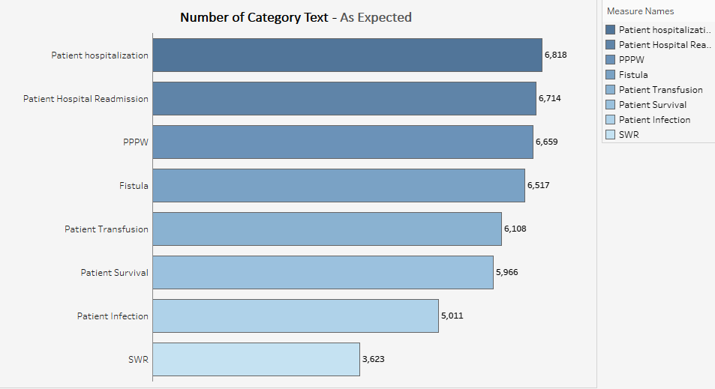
KPI - 5 # of Category Text - As Expected

Slide 25
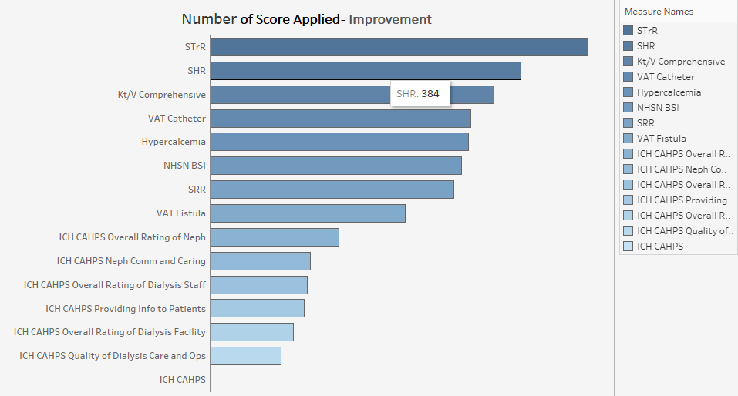
KPI - 6 # of Score Applied – Improvement

Slide 26
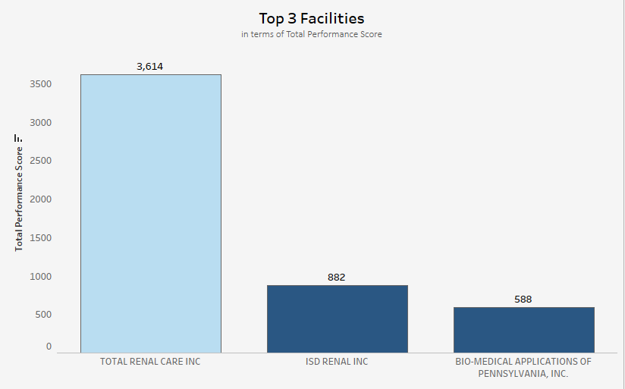
KPI - 7 Top 3 Facilities in terms of Total Performance Score

Slide 27
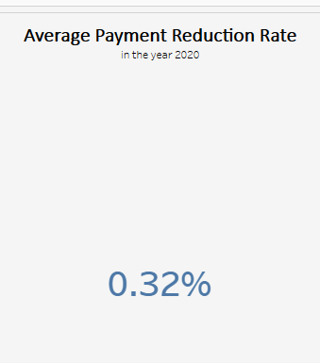
KPI - 8 Average Payment Reduction Rate for 2020

Slide 28
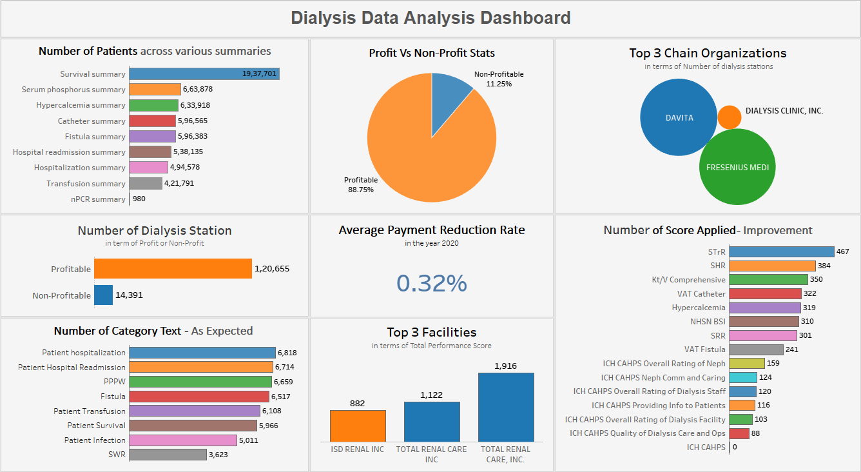

Slide 29

Kpi’s In Power BI

Slide 30
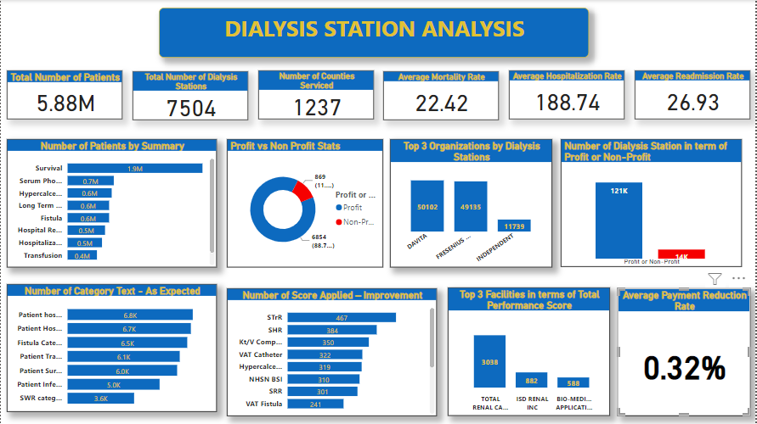

Slide 31

THANK YOU..

